Slide 1

OSS Network Testing breaking the network, not the bank
This presentation is licensed under a Creative Commons Attribution-NonCommercial-ShareAlike 3.0 Unported License.
(C) 2017 jim@openoid.net
Jim Salter
Technomancer,
Mercenary Sysadmin,
Small Business Owner
Today's slides can be found at:
http://openoid.net/presentations/

Slide 2
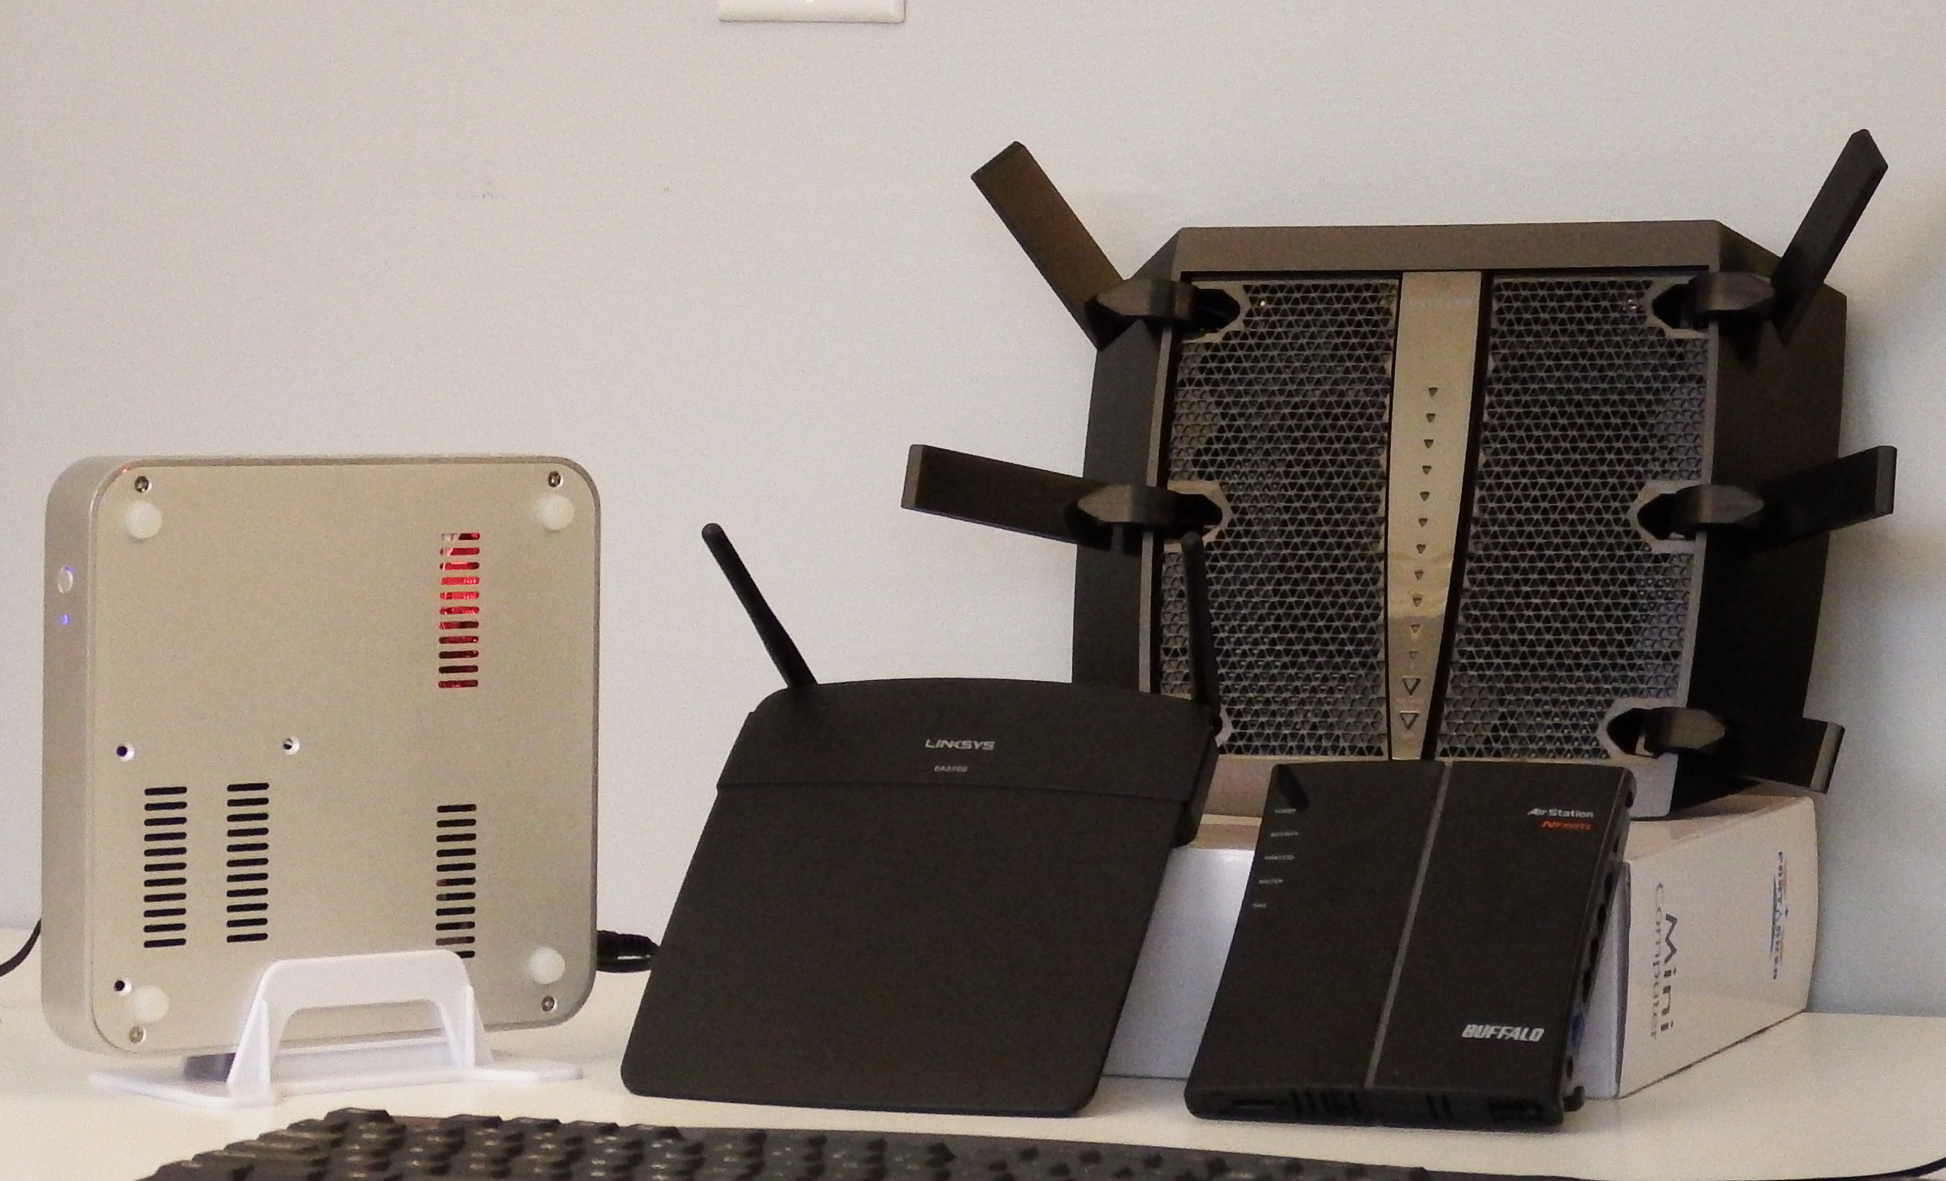
A couple of years ago, I got
really interested in routers.

Slide 3

The stuff written on the box
tends to be a little… optimistic.

Slide 4
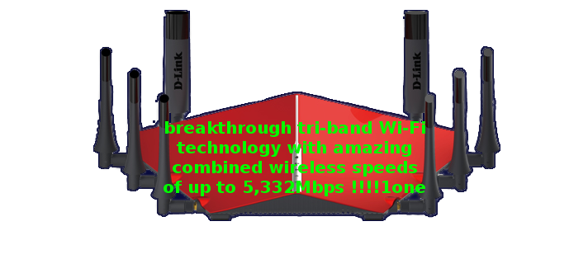
… and then there’s wi-fi.

Slide 5
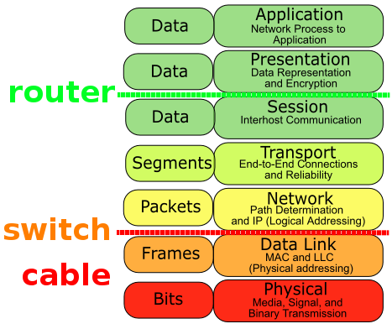


Run iperf, big numbers, go home?

Slide 6

I always want free speech
But this time, I also needed the beer!
$$$

Slide 7

Besides, I like real protocols.
mount -t cifs ; time cat /stuff

Slide 8

Besides, I like real protocols.

Slide 9
ab, smaller numbers, go home?
… better, but no ability to model
me@banshee:~$ ab -c10 -t3 http://192.168.0.30/1M.bin
This is ApacheBench, Version 2.3 <$Revision: 1706008 $>
Copyright 1996 Adam Twiss, Zeus Technology Ltd, http://www.zeustech.net/
Licensed to The Apache Software Foundation, http://www.apache.org/
Benchmarking 192.168.0.30 (be patient)
Completed 5000 requests
Completed 10000 requests
Finished 11486 requests

Slide 10

moving past the
Downloading
Browsing
VoiP...ing
Streaming
single client test model

Slide 11
enter the hydra
net-hydra -c {configfile} [-t {testname}]
net-hydra requires a config file specifying [clients], [directives], and optionally
[aliases], which it uses to schedule jobs to run simultaneously in the very near future
on multiple client machines.
# sample nethydra.conf
[clients]
local0 = root@127.0.0.1
local1 = root@127.0.0.2
[directives]
# These are the command(s) to be run on each client device. Directives
# beginning with $ reference lines from the [aliases] section. Any use
# of $when, either here or in [aliases], will be replaced with the
# scheduled execution time, in Unix epoch seconds; $testname is replaced
# with the --testname argument passed to net-hydra on the command-line.
local0 = $4kstream
local1 = /usr/bin/touch /tmp/test-$testname-$when.txt
[aliases]
# Defining aliases here keeps [directives] cleaner, so you can
# see what you're doing a little more easily.
#
$4kstream = netburn -u http://127.0.0.1/1M.bin -r 25 -o /tmp/$testname-$when.csv

Slide 12
feel the burn
netburn -u {url}
[-r {rate limit} ] ... specified in Mbps (default none)
[-t {seconds} ] ... time to run test, default 30
[-o {filespec} ] ... output filespec for CSV report
[--no-header ] ... suppress header row of CSV output
[-h {hostname} ] ... override system-defined hostname
in CSV output
[-c {concurrency} ] ... number of concurrent URL fetches to
make per 'page' fetch
[-q ] ... quiet (suppress all but CSV output)
[-ifinfo {iface} ] ... output detailed wifi info about {iface}
[--usage ] ... you're looking at this right now

Slide 13
feel the burn
you@box:~$ netburn -u http://server/128K.bin -r 10
Fetching http://server/128K.bin at 10 Mbps for 30 seconds.
Throughput so far: 10.01 Mbps
Seconds remaining: 0
Time elapsed: 30.2 seconds
Number of pages fetched: 301
Total data fetched: 37.6 MB
Mean page length fetched: 1048576 KB
Page length maximum deviation: 0 KB
Throughput achieved: 10 Mbps
Mean latency: 41.65 ms
Worst latency: 190 ms
99th percentile latency: 51 ms
95th percentile latency: 46 ms
90th percentile latency: 45 ms
75th percentile latency: 43 ms
Median latency: 41 ms
Min latency: 35 ms

Slide 14
whenits {time}, run {command}
(because at is only granular to 1m, wtf?)
whenits [-d] {time} {/path/to/command {arg1 arg2 arg3 ...} }
-d ... optional: daemonize (fork and run in
background). You'll need this if you're
scheduling commands that need to run after
the current shell closes.
time ... Required. Execution time may be specified
in absolute epoch seconds, or relative to
current time - eg now+5s, now+10m, now+2h.
command ... the command to be scheduled at {time},
along with any arguments to be passed to it.

Slide 15
getting results
Downloading
Browsing
VoiP...ing
Streaming
multiclient test model

Slide 16
wi-fi: it’s all about the
aggressive spectrum use auto band steering
– – vs – – manual band allocation radios and access points
collision domains

Slide 17
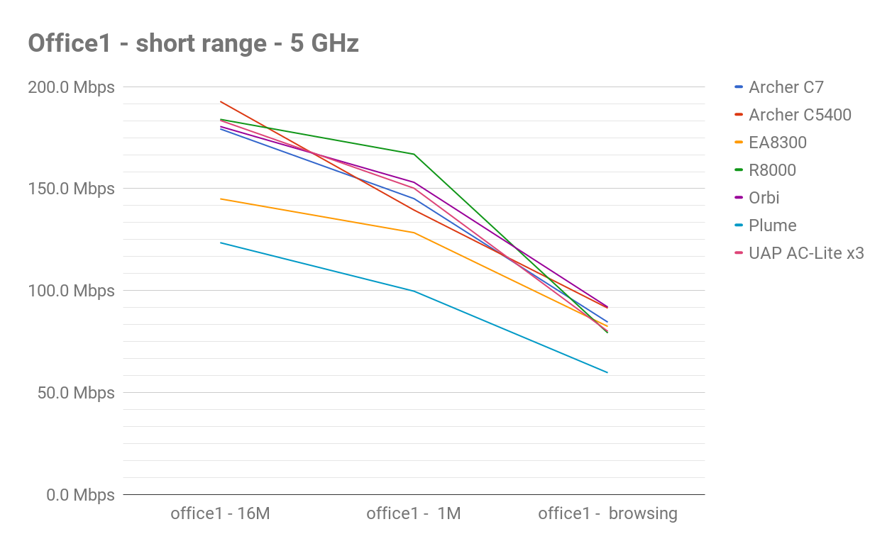
single-client testing
ho, hum

Slide 18
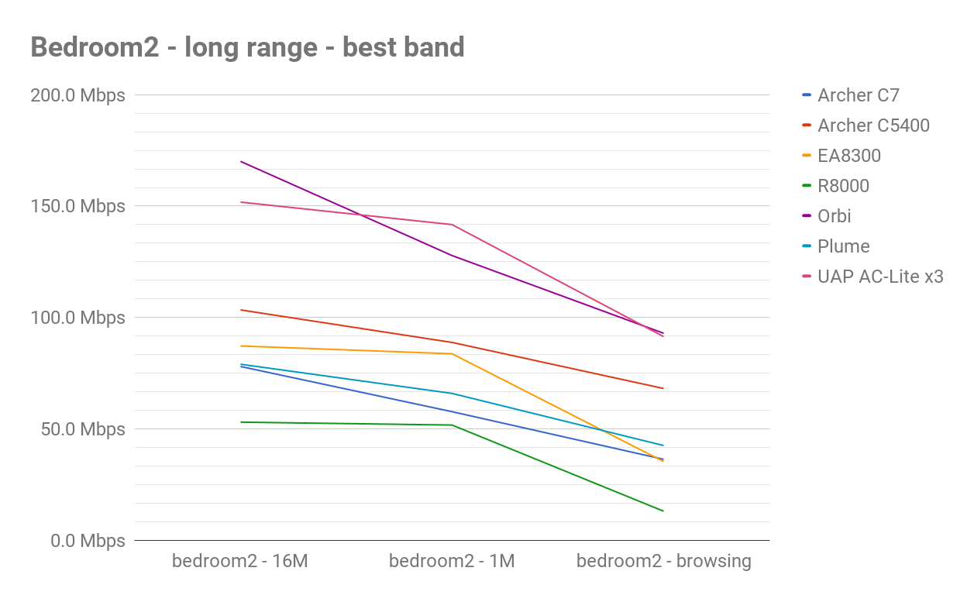
single-client testing
ho, hum, at long range

Slide 19
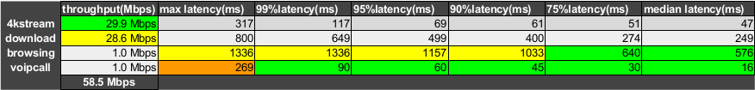
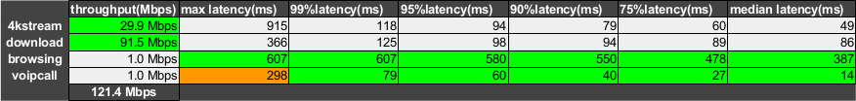
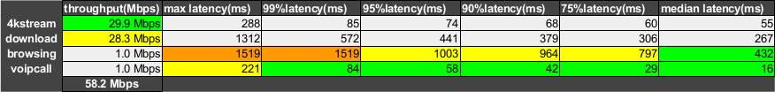
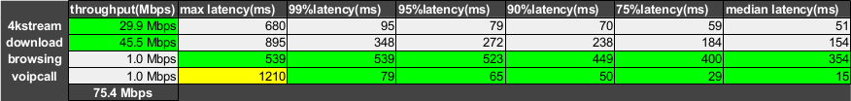
multi-client testing
Archer
C7
Archer
C5400
Linksys
EA8300
Netgear
R8000
easy mode (manual)

Slide 20
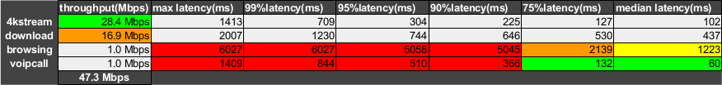
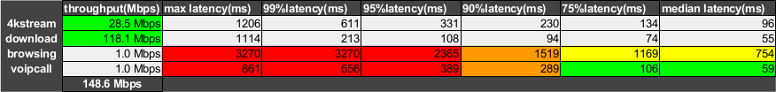
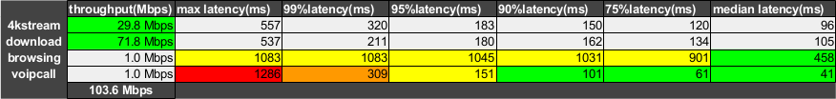
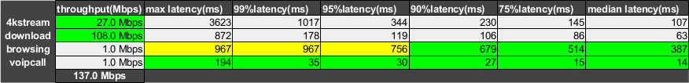
multi-client testing
Archer
C7
Archer
C5400
Linksys
EA8300
Netgear
R8000
hard mode (bandsteer)

Slide 21
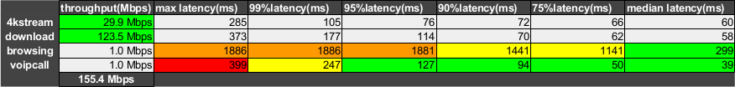
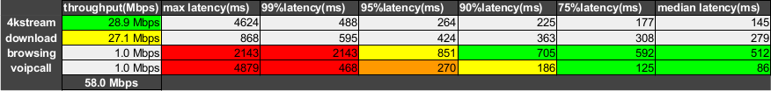
bring on the mesh!
Netgear
R8000
Netgear
Orbi
Plume
… but remember how flaky R8800 was in bedroom2.

Slide 22
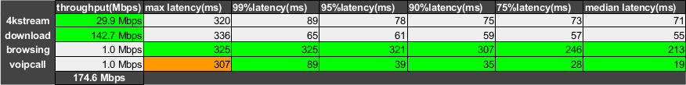
Boo Plume. Yay Ubiquiti!
Netgear
Orbi
Plume
Ubiquiti
UAP-AC
Lite x3
Collision domains: they matter.

Slide 23







Questions?
Comments?
Angry denunciations?
https://github.com/jimsalterjrs/network-testing

